Slide 1
CTS2 Introduction and Overview Introduction to the Common Terminology Services 2 Standard
Scott Bauer, Cory Endle
HL7 Working Group Meeting
May 7th, 2013
Notes:
Welcome
Introductions
Long and Complex
Dense dark forest
A set of trees

Slide 2
Purpose and Outline
Provide a background to Terminology Services
Outline the process and history culminating in the completion of the specification
Describe the artifacts of this process and their purpose
Discuss the architecture of the API and how it can be implemented
Report on and demonstrate current implementations
Notes:
we’ll take questions at the summary of each section.

Slide 3
Communication is about Language
Language - a “specification” that enables communication
Semantics - the association between signs or symbols and their intended “meaning”
Syntax - the rules for ordering and structuring the signs into phrases and sentences
Pragmatics - the relationship between signs and symbols and the recipient. Broadly, the shared context.
Notes:
We can’t discuss terminology services without discussing terminologies
And if we discuss terminologies, then we need to discuss language

Slide 4
The Semiotic Triangle
Thought or Reference
Refers to
Symbolizes
Referent
Stands for
Symbol
C.K Ogden and I. A. Richards. The Meaning of Meaning.

Slide 5
The Semiotic Triangle
Thought or Reference
Refers to
Symbolizes
Referent
Symbol
Referent
Stands for
“Rose”
C.K Ogden and I. A. Richards. The Meaning of Meaning.

Slide 6
The Communication Process
CONCEPT
CONCEPT
Refers To
Symbolizes
Symbolizes
Refers To
“I see a ClipArt image of a rose”
“Rose”,
“ClipArt”
“Rose”,
“ClipArt”
Referent
Stands For
Stands For
Symbol
Symbol

Slide 7
The Communication Process
Semantics
CONCEPT
CONCEPT
Refers To
Symbolizes
Refers To
“I see a ClipArt image of a rose”
Symbolizes
“Rose”,
“ClipArt”
“Rose”,
“ClipArt”
Referent
Stands For
Stands For
Symbol
Symbol

Slide 8
The Communication Process
Semantics
CONCEPT
CONCEPT
Refers To
Symbolizes
Symbolizes
Refers To
“I see a ClipArt image of a rose”
“Rose”,
“ClipArt”
“Rose”,
“ClipArt”
Referent
Stands For
Stands For
Symbol
Symbol
Syntax

Slide 9
The Communication Process
Semantics
CONCEPT
CONCEPT
Refers To
Symbolizes
Symbolises
Refers To
“I see a ClipArt image of a rose”
“Rose”,
“ClipArt”
“Rose”,
“ClipArt”
Referent
Stands For
Stands For
Symbol
Symbol
Context
Context
Syntax
Shared Context

Slide 10
Common Forms of Contextual Formalism
Dictionaries
Thesauri
Textbooks, college courses, etc.
Operations manuals
Data dictionaries
… Ontologies (recent)

Slide 11
AKA… Terminology
Dictionaries
Thesauri
Textbooks, college courses, etc.
Operations manuals
Data dictionaries
… Ontologies (new)

Slide 12
“Terminology”
A generic “term” that covers a broad spectrum:
Code / Value pairs – Country codes, airline codes, fare codes, ...
Controlled vocabularies – when United Airlines uses “confirmed reservation”, they mean “...”
Thesauri – if you’re are looking for information on the Tiger Swallowtail, you might also look at books with butterfly pictures, books about insect migration
Notes:
Dictionary example
How do we understand the greater context of language and terminologies?

Slide 13
“Terminology” (continued)
Classifications – “buckets” for various statistical and information gathering purposes. Example: ICD-9-CM – 250.01 “Diabetes Mellitus with complication, type 1, not stated as uncontrolled”
Formal Logic Systems – Web Ontology Language (OWL), OBO, Common Logic, .... Classes, individuals relationships. SNOMED-CT, Gene Ontology, FMA, CYC, SUMO, ...
Notes:
Ontologies: Might actually support or express some of the ways we know how our language works,

Slide 14
Why Terminology Services?
Start with a simple example – the ISO Country Codes:
Where can you get them?
What formats are they available in?
How are they organized? How do I list just EU countries? Countries in Africa?
Oh – they change???? How do I know when a change occurs? How do I know what happened?
Notes:
Transitional slide beforehand

Slide 15
Why Terminology Services?
Ok – I’ve downloaded them...
I create a set of SQL tables...
... construct some queries to create a dropdown list for a form
... write an Ajax application for my web page
... write some more queries to print the full names on a report
Notes:
Explain Ajax

Slide 16
Why Terminology Services?
Discover the accounting package needs three character codes
Repeat the download and write a conversion
Discover the accounting package hasn’t updated their tables since 1990... - what do we do with “YU”
Discover ISO reuses codes (!!!)

Slide 17
Why Terminology Services?
We’ve just been bought... our new owner doesn’t use ISO codes
... we’ve got to start translating between ISO codes and 01-299 codes
... and they’ve got “YU”...
... and they now need to know what currencies are (and were) used in a given country...

Slide 18
Why Terminology Services?
Take the scenario above and figure that a reasonably complex business such as a medical practice may have to deal with
.... hundreds of tables / classifications / relationships each with its own formats, labels, release cycles, rules
... many applications that define, create and consume these terminologies

Slide 19
Why Terminology Services?
... other businesses with the same information but different codes and formats
.... An ever increasing load of reporting / analysis / billing requirements ...

Slide 20
Why Terminology Services? Terminology Service Requirements
At some point, it begins to make sense to try to come up with:
A catalog of terminologies
Who maintains them, what they are for, how often they are updated, what they cost, ...
A simple way to download, deploy and update their content

Slide 21
Why Terminology Services? Terminology Service Requirements
A way to ask similar queries in the same way:
By textual content – “All currencies that use the ‘$’ symbol”
By organization – “All EU countries”
By relationship – “All countries that share a border with France”
By secondary set – “All countries that are HL7 members”

Slide 22
Why Terminology Services? Terminology Service Requirements
Reasoning
Maps between terminologies
Incremental updates
Local extensions
“Binding” to data elements
Different output formats
Notes:
Verbage for reasoning

Slide 23
Why Terminology Services? Summary
SOA and information exchange require shared semantics (terminology)
Shared semantics, in turn, requires shared terminology
No one can afford to do their own research, write their own importers, access methods, Ajax widgets, update mechanisms, etc.
Notes:
Service Oriented Architecture

Slide 24
Why Terminology Services? Summary
Terminology Service Standards provide:
Semantics for terminology
Shared exchange models
Complete and robust requirements
Common API’s
Notes:
Questions at this point

Slide 25
Terminology Services A Short History

Slide 26
Common Terminology Services A Short History: OMG and CTS
CTS2 Derives from:
OMG Lexical Query Service (LQS) Standard (1999)
OO Model, read only, but laid most of the foundation for subsequent efforts
HL7 CTS Specification (2004)
ANSI and ISO Standard
SOA Model, read only, reduced scope from LQS
Notes:
SOA – Service Oriented Architecture helps to define interoperability

Slide 27
Common Terminology Services A Short History: CTS
Developed to meet HL7 requirements:
LQS was deemed too big to implement
Designed to be read only
Versioning and revisions not included in the specification

Slide 28
Common Terminology Services A Short History: CTS
Formal Specification in:
UML model
OMG IDL language
This was released prior to a complete Model Driven Architecture standard
Needed to get from UML to Java
Apache Axis produced a WSDL and Java Beans were derived from that WSDL
Notes:
IDL (Interface Description Language) is a specification language used to describe a software component's interface
WSDL an XML format for describing network services as a set of endpoints operating on messages

Slide 29
Common Terminology Services A Short History: CTS
The specification was designed in two distinct layers
A message API (Application Programming Interface)
A vocabulary API
Notes:
Message API, communicates with the messaging software, and does so in terms of vocabulary domains, contexts, value sets, coded attributes and other artifacts of the HL7 message model.
Vocabulary API, communicates with the terminology service software, and does so in terms of code systems, concept codes, designations, relationships and other terminology specific entities

Slide 30
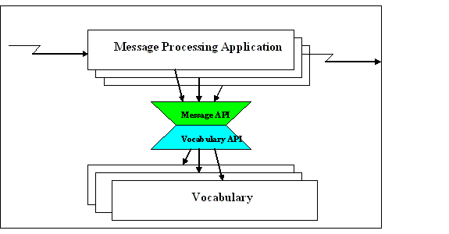

Common Terminology Services A Short History: CTS
Notes:
In this example, an application requests that the Message Runtime Service fill out the details of a CD-derived attribute. The Message API service, in turn, makes multiple calls to the Vocabulary API service in order to get concept code designations, code system names, release versions, etc.

Slide 31
Common Terminology Services A Short History: CTS
Vocabulary Translation Layer
Code map (minimal one-to-one code system level map)
Notes:
Add graphic here

Slide 32
Common Terminology Services 2 A Short History: CTS2
CTS2 Derives from (continued):
Mayo LexGrid information model (2002 – present and also derived from the Lexical Query Service)
National Cancer Institute NCI LexEVS (2005 – present)
HL7 Service Functional Model (SFM)
Work and insights of many individuals and organizations...

Slide 33
Common Terminology Services 2 Approach
Developed via the Healthcare Services Specification Program or HSSP process:
HL7 issued the starting requirements document (HL7 SFM)
Requirements transferred to Object Management Group (OMG), which issued a Request for Proposal through the Ontology Platform Committee
Participants drawn from W3C, Healthcare, XML, Space, Finance and other communities
Notes:
HSSP collaborative effort between OMG and HL7 to identify and document service specifications, functionality, and conformance supportive and relevant to healthcare IT stakeholders and resulting in real-world implementations.

Slide 34
Common Terminology Services 2 Approach
Developed via the HSSP process (continued)
Specification submitted to OMG and balloted June 2011. Issued as a “Beta” spec
Implementations developed, issues submitted to CTS2 Finalization Task Force
Accepted for adoption by the OMG in August 2012 – available on OMG web site

Slide 35
Healthcare Services Specification Project Approach: (HSSP) Workflow
HL7
OMG
Vendor
Community
1
SFM
SFM
2
RFP
We Are
Here…
Proposed
Standard
HL7
Implementation
Guide
3
Beta
Standard
FTF
4
4
Vocab committee
Normative
process
Corrections / Clarifications
Final
Standard
5
Notes:
----- Meeting Notes (12/27/12 14:02) -----
Out of the vocabulary working group the SFM was created by multiple contributers. This ducument captured the functionality required by a terminology service.
Published as a Draft Standard for Trial Use. Handed over to the OMG, and an RFP was issued for the community to respond with the intent of having a implementation and PIM and PSM created. There were multiple responders, and they were required to harmonize their response. That response included not only a PSM and a PIM, but also one for soap and one for REST.(3). At that point the proposal was accepted by OMG and a beta standard was made available for review. The beta was available for one year and during that time a task force was put into place and the finalization task force addressed any community issues or concerns. At the completion of the FTF the final standard was submitted to the OMG and approved as the standard. As part of that submission the responder to the RFP had to deliver a letter of intent stating they would deliver an implementation validating the standard. Because the original SFM was a draft standard which expired, the final OMG standard is in the normative process which will release an official standard. The implementation guide will be completed after the standard is normative.

Slide 36
CTS2 Service Functional Model (SFM) Approach: SFM
SFM insured that the implementation was complete
Describes use cases and functionality for the specification
Balloted as a draft standard for trial use (DSTU)
Turned over to OMG where it was used to create a Platform Independent Model or PIM and a Platform Specific Model or PSM.
Now moving toward a normative specification in the vocabulary committee

Slide 37
CTS2 PIM, Platform Independent Model Approach: The role of the PIM
A Unified Modeling Language (UML) representation:
Defines names, purpose and how used
No physical rendering (i.e. Java Beans, C++ classes, XML schema, etc.)
The PIM can be transformed into multiple different Platform Specific Models
This is where you go when you have detailed questions about the specification
Notes:
No physical rendering means there is no API or interface an application can interact with.
The PIM can be transformed into multiple different platform specific models.

Slide 38
CTS2 PIM, Platform Independent Model Approach: The role of the PIM
Comprised of an:
Information Model
Core
CTS2 Resources
Computational Model
Core
CTS2 Operations
Notes:
Data Model
Services offered by the Terminology Service

Slide 39
CTS2 PSM: Platform Specific Model Approach: The Role of the PSM
CTS2 representations in
XML schema, allowing content to be created in XML (A PSM of the Information Model)
WADL: a REST interface to the the computational and information model
WSDL: a SOAP interface to the same computational and information model
Notes:
We’ve described the artifacts of this process and in sum they comprise CTS2

Slide 40
CTS2 Specification
A model and specification for discovering, accessing, distributing and updating terminological resources on the internet.
Notes:
Questions on the process and it’s artifacts here

Slide 41
CTS2 Specification
The CTS2 specification provides:
A model and set of symbols for discussing terminology:
Formal in UML
Practical in XML Schema
A RESTful Architecture for querying, exchanging and updating terminological content

Slide 42
CTS2 Specification Resource-Oriented Architecture
It's just four concepts:
Resources
Their names (URIs)
Their representations
The links between them
And four properties:
Addressability
Statelessness
Connectedness
A “uniform interface”
RESTFul Web Services – Richardson and Ruby, 2007
Notes:
Resources: anything that is important enough to have a link to it.
Representation: the data of the resource
Addressability: Expresses each important part of its data as a URI
Statelessness: The service doesn’t allow one REST call to build on another.
Connectedness: Representations can just be data but they can also be data and links to other resources
Uniform interface: GET,PUT, POST, DELETE

Slide 43
CTS2 Specification Why REST?
Enables “Linear Value Proposition”
Easy things should be easy
Cost of adding complexity should be linear
(Charlie Mead, 2011)
Proven Technology
Architecture of the World Wide Web
Can leverage existing WWW tools (HTTP / XML / XSLT / …)
Enables modular architecture
Notes:
Linear Value Proposition is best understood to mean that a given component should provide "just enough interoperability" to accomplish what is needed to accomplish, in the context in which it is being deployed.
Might add to that just enough functionality.
----- Meeting Notes (1/9/13 14:57) -----
Attribution: Charlie Mead

Slide 44
CTS2 Specification API
CTS2 is an Application Programming Interface (API) specification.
It defines the semantics, syntax and valid interactions that can occur
It is a “blueprint” for software
If everyone follows the blueprint (and the blueprint is sufficiently precise) then CTS2 clients and services can interoperate
Notes:
footer

Slide 45

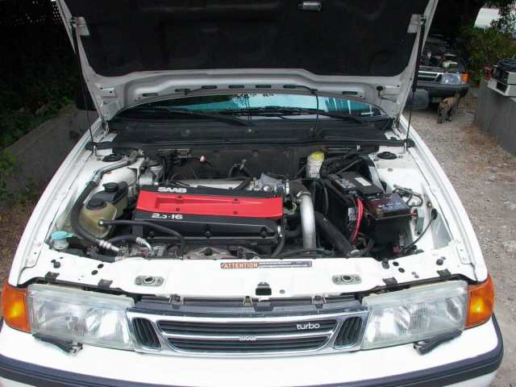

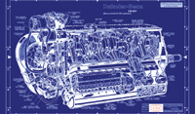


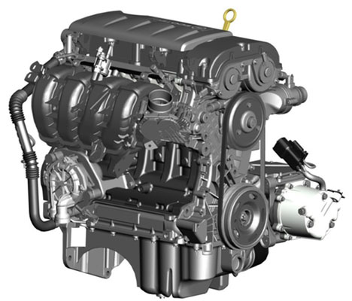
CTS2 Standard as a Blueprint
CTS2 Clients
CTS2 Services
Notes:
An analogy might be a blueprint for an engine - a detailed specification of the various parts that go into engine assembly as well as the dimensions, requirements, etc. that would allow the engine to be used in a motor vehicle. This blueprint would allow engine manufacturers (terminology service providers) to assemble some or all of the components of the engine in a way that would allow them to be assembled into a variety of working models. At the same time, vehicle manufacturers (client software developers) could configure their components in a way that would allow engines from different manufacturers to be used in the same vehicle.

Slide 46
Modular Specification Implement / use what you need
Code System Catalog Entry and Code System Version Catalog Entry
Entity Description and Association
Value Set Catalog Entry, Value Set Definition and Resolved Value Set
Map, Map Version
Concept Domain and Concept Domain Binding
Statement Model

Slide 47
Modular Functionality Implement / use what you need
Read
Query
Import
Export
Update
Maintenance
History
Temporal
Notes:
Create Read Update and Delete

Slide 48
Each Module (or Resource) Has
Formal Information Model in UML
Defines the resource, how it is identified and what information it contains
Formal Computational Model in UML
Defines operations that are available for each functional (read, query, import, …) profile

Slide 49
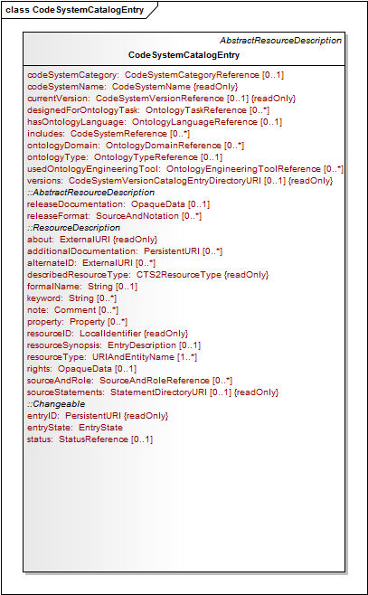
codeSystemName: CodeSystemName {readOnly}
about: ExternalURI {readOnly}
Formal
Information
UML
resourceID: LocalIdentifier {readOnly}
resourceType: URIAndEntityName[1..*]
entryID: PersistenURI {readOnly}
entryState: EntryState
Notes:
Class like object with a title and set of attributes
entryID - the globally unique identifier of the resource.
entryState - an indicator that states whether the Changeable element is ACTIVE, and subject to searching and browsing access or INACTIVE, meaning that it is only accessible if its identity is already known or if the service calls specifically state that they want to see inactive service elements.
about - the (or a) definitive URI that represents the resource being described.
resourceID - a local identifier that uniquely names the resource within the context of the
describedResourceType and implementing service.
resourceType - the class(es) that this resource instantiates.

Slide 50
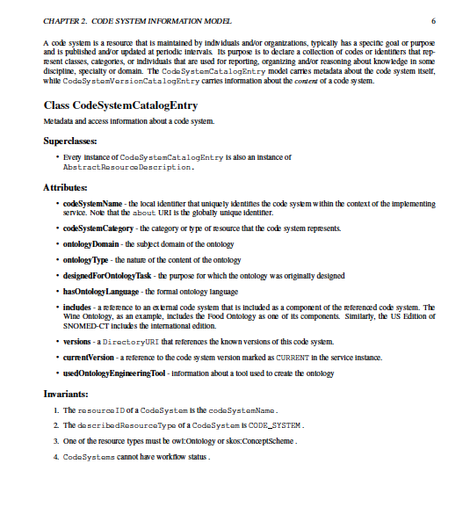
codeSystemName - the local identifier that uniquely identifies the code system within the context of the implementing service. Note that the about URI is the globally unique identifier.
Formal
Information
UML

Slide 51
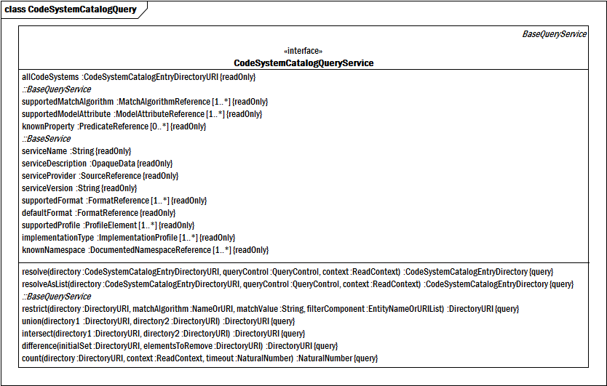
Formal Computational Model
resolve
resolveAsList
Notes:
Query Service which has both attributes and operations.

Slide 52
Each Module Also Has
XML Schema representation of the Information Model
WADL (Web Application Description Language) a rendering of Computational Profiles
Defines the URLs + operations (GET, PUT, POST, DELETE) that implement the computations

Slide 53
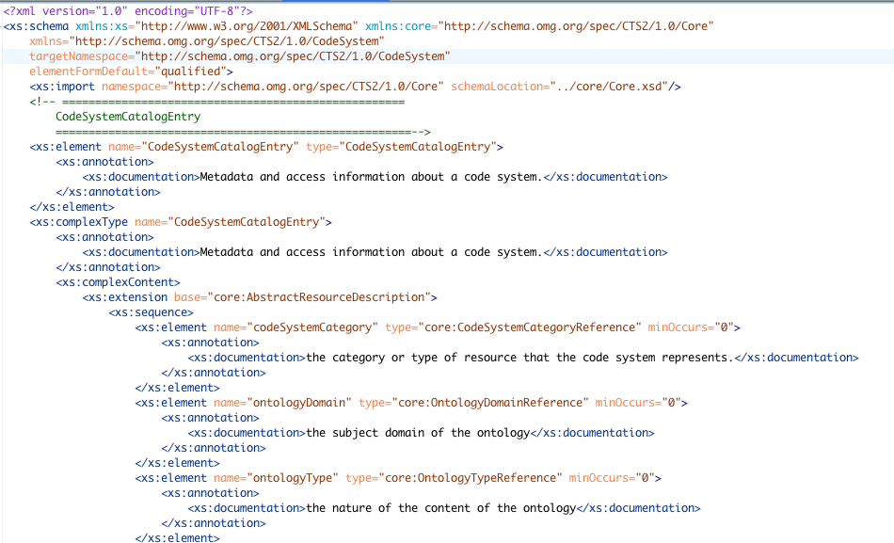
XML Schema Sample
Notes:
XML Schema allows the user to open an XML editing tool and create content for a given module. Allows you to create content that will be validated against the structure of the schema.

Slide 54
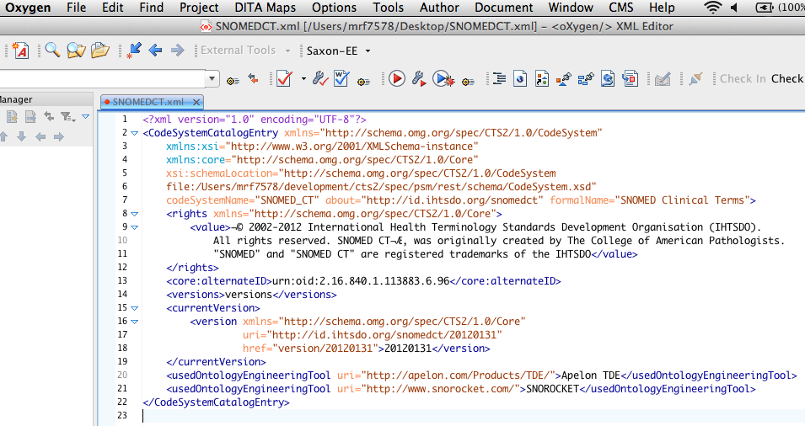
Content Can be Created with Any XML Compliant tool
Notes:
footer

Slide 55
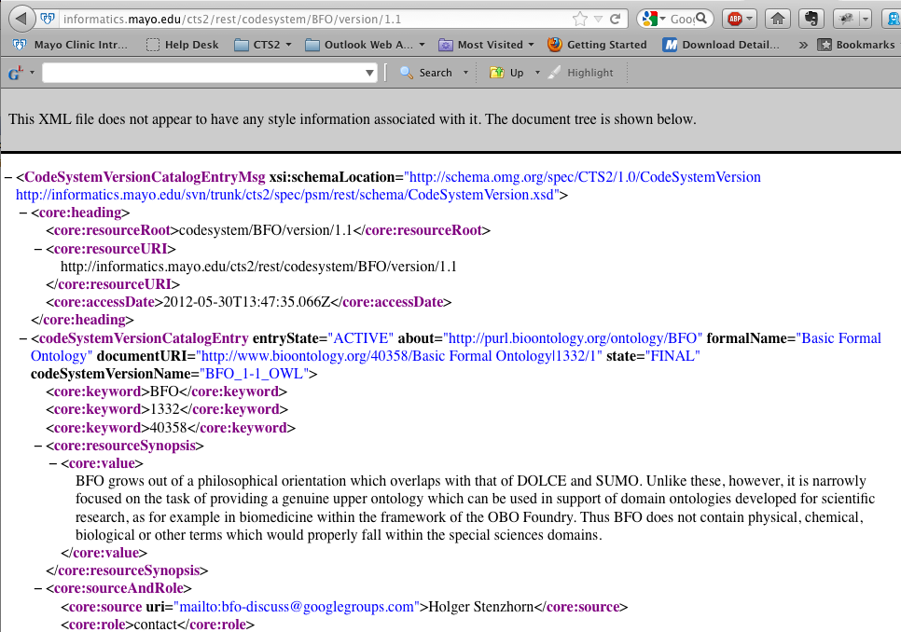
And published as http… http://informatics.mayo.edu/cts2/rest/codesystem/BFO/version/1.1

Slide 56
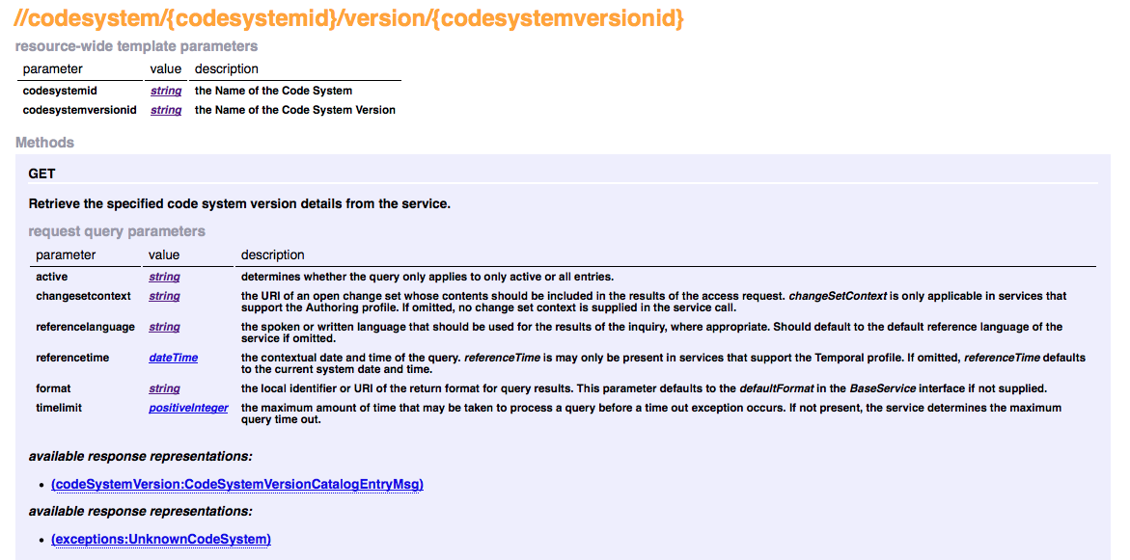
WADL Sample http://informatics.mayo.edu/svn/trunk/cts2/spec/psm/rest/html/cts2.html
codesystemid; the Name of the Code System
codesystemversionid; the Name of the Code System Version
Active: determines whether the query only applies to only active or all entries.
format: allows a determination of format
codeSystemVersion: CodeSystemVersionCatalogEntryMsg
Notes:
Using the codesystemid and codesystemversionid you can run the GET method. Note active and format params, mention responses.

Slide 57
Each Module Has
WSDL Rendering of Computational model
Allows SOAP (RPC) access
JSON rendering of Information Model
Not “formal” standard
Enables Ajax (browser as a service client)

Slide 58
Combined they provide a set of rules that:
Describes (some of) what can be said about various aspects of terminologies
Provides a straight-forward format for structuring the information
Provides rules for publishing, querying, exchanging and updating information in a distributed, federated environment
Notes:
Fix footer
----- Meeting Notes (1/3/13 13:29) -----
Describe distributed and federated

Slide 59
… Or …
Web Services / SOAP Publish Discover…
JAVA Objects
JSON and other (standardization still underway)

Slide 60
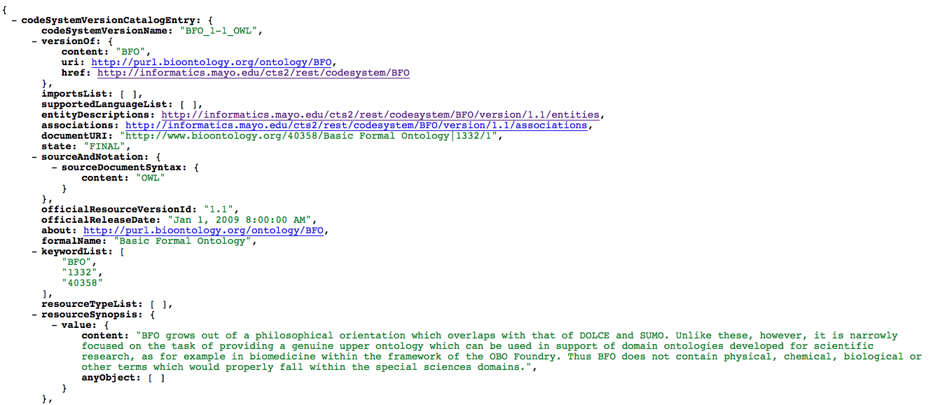
JSON
Notes:
Not a formal part of the standard but Important because it allows things to happen right on the web page.

Slide 61
CTS2
The CTS2 standard is actually a collection of relatively small standards…
… and a set of assembly rules.
The goal of the CTS2 standard is distribution and federation:
Distribution means that different organizations can publish different aspects
Federation means that organizations can share
Key is that implementations can be shared…
… no one has to do it all!

Slide 62
CTS2 Design Philosophy
Simple things should be simple
Representational State Transfer architectural style but will support SOAP
Modular components allow implementation of a subset of a larger specification (Component Resources)
Notes:
Questions and discussion here

Slide 63
CTS2 Component Resources
Code System Catalog
Code System Version Catalog
Entity Description
Association
Map Catalog
Map Version
Concept Domain Catalog
Concept Domain Binding
Value Set Catalog
Value Set Definition
Resolved Value Set
Notes:
Code System Catalog – metadata about code systems (ontologies, code sets, thesauri, classification systems, etc.). A service would implement this section to publish information about what sort of terminological resources are available, who maintains them, what they are intended to be used for, how often they are released, what copyrights pertain to them, etc.
Code System Version Catalog – metadata about specific versions of code systems. A service would implement this section to provide information about specific versions of code systems – when they were released, what format they are in, when they were intended to become active, which version they replace, etc.
Entity Description – a set of entity (aka. “class”, “category”, “concept”, “predicate”, “property”, “term”, “individual”) identifiers known to the service along with information about which code system versions make assertions about these identifiers and what they say. The entity description service focuses on the lexical aspect of entity identifiers – providing access to the designations, definitions, descriptions, examples, usage notes and other artifacts used to represent the meaning of the entity to human consumers. Services would implement this section to publish information about the codes described in various versions of code systems along with their intended meanings.
Association – sets of “semantic” assertions about entity identifiers, in which the entity identifier may play the role of subject, predicate (verb) or object in the assertions. This area represents the formal machine interpretable aspects of code systems, and a service would implement this section to support classification, reasoning or other computational logic systems built on terminological content.
Value Set Catalog – metadata about sets of entity identifiers (value sets) that have been grouped for some purpose. A service would implement this section if it wanted to publish information about these collections such as who created them, who maintains them, what is their purpose, what code systems do they depend on, how they are updated, etc.
Value Set Definition - information about how value sets are constructed. A value set definition can be a simple enumeration of its elements or can contain instructions about how the elements are assembled from aspects of entity descriptions and associations. Value set definitions may be coupled to specific versions of code system, or may be defined in a way that they could be applied to different versions, potentially with different results. Services would implement this section to publish the rules on the construction of value sets. The value set definition section includes an optional sub- section (Resolved Value Set) that enables the publication, loading and use of the results of applying value set definitions. Services would implement this section when they needed to consume and use value sets without having access to the underlying code systems.
Concept Domain Binding – the coupling of a concept domain with a value set, where the value set provides a list of possible meanings that can be used in a concept domain in a particular use case or context.
Map Catalog – a catalog of “maps” - collection of rules that allow human or machine assisted transformation between the codes in one value set or code system and those in a second. A service would implement this section to publish information about which rule sets are available, which code systems or value sets they map between, their intended purpose, how often they are published, what formats they are in, etc.
Map Version – an instance of a map, including the specific value set definitions that and code systems that they are based on and the actual rules. A service would implement this section if it wished to publish the content of maps. This section includes an optional sub-section (Map Resolution) that provides access to the machine aided interpretation of map versions – a service that does the actual map transformation.
Statement - a bridge between the information contained in the various sections described above and the actual assertions made by the information providers. A service would implement this section when it needed to provide additional provenance about assertions made in catalogs or resource versions including what was actually said, how it mapped to the CTS2 service representation, the provenance of the assertion, etc. Statement is also intended to act as a bridge between the structured CTS2 model and simple subject/predicate/target systems as represented by OWL and RDF.

Slide 64
CTS2 Component Resources Code System Catalog Module
Metadata about code systems (ontologies, code sets, thesauri, classification systems, etc.)
A service would implement this section to publish information about:
What sort of terminological resources are available
Who maintains them, what they are intended to be used for
How often they are released
What copyrights pertain to them, etc.
Notes:
Each defines a Code System
And would contain attributes such as: A code system name, Ontology category or type of resource, Ontology domain: subject domain of the ontology, Ontology type: nature of the ontology content
Any external code systems it may include, A Uri to other versions, The current version

Slide 65
CTS2 Component Resources
Code System Version Catalog Module

Slide 66
CTS2 Component Resources Code System Version Catalog Module
Metadata about specific versions of code systems.
A service would implement this section to provide information about specific versions of code systems:
When they were released
What format they are in
When they were intended to become active
Which version they replace

Slide 67
CTS2 Component Resources
ENTITY DESCRIPTION MODULE

Slide 68
CTS2 Component Resources Entity Description Module
A set of entity identifiers known to the service
These might also be thought of as:
Class
Category
Concept
Predicate
Property
Term
Individual

Slide 69
CTS2 Component Resources Entity Description Module
Code system version information:
Which code system versions make assertions about these identifiers
What the codes systems say about them
Their intended meanings
What elements in the code system are their children, parents

Slide 70
CTS2 Component Resources Entity Description Module
The entity description service focuses on the lexical aspect of entity identifiers:
Providing access to:
Designations
Definitions
Descriptions
Examples
Usage notes and other artifacts used to represent the meaning of the entity to human consumers

Slide 71
CTS2 Component Resources Entity Description Module
Why would services implement this module?
To publish information about the codes described in various versions of code systems
Notes:
Also contains attributes defining whether and what its parents and children might be in the scope of the code system. Whether it is the subjectof, predicate of or target of another entity. It defines an entity type in owl, rdf or skos types. Entity description in sum supplies many of the use cases needed by the user of a terminology service. Available is information about the code systems, relationships to other codes in the code system, and the entities themselves

Slide 72
CTS2 Component Resources
ASSOCIATION MODULE

Slide 73
CTS2 Component Resources Association Module
Sets of “semantic” assertions about entity identifiers
The entity identifier may play the role of
Subject
Predicate (verb) or
Object
… in the assertions

Slide 74
CTS2 Component Resources Association Module
This area represents the formal machine interpretable aspects of code systems
A service would implement this section to support:
Classification
Reasoning or other computational logic systems built on terminological content
Notes:
Reasoning a more general example of inferencing
We know from set theory that asserting x->y and y->z allows us to say x->z

Slide 75
CTS2 Component Resources
VALUE SET CATALOG MODULE

Slide 76
CTS2 Component Resources Value Set Catalog Module
Metadata about sets of entity identifiers (value sets) that have been grouped for some purpose
A service would implement this section if it wanted to publish information about these collections such as:
Who created them
Who maintains them
What is their purpose
What code systems do they depend on
How they are updated, etc.
Notes:
Why group entity identifiers together. Give race or gender example. Catalog gives you the initial list of what’s available.

Slide 77
CTS2 Component Resources
VALUE SET DEFINITION MODULE

Slide 78
CTS2 Component Resources Value Set Definition Module
Information about how value sets are constructed.
A value set definition can:
Be a simple enumeration of its elements
Or can contain instructions about how the elements are assembled from aspects of entity descriptions and associations.
Notes:
Enumeration or a query against metadata contained in the entity properties or relationships allowing a dynamically assembled group of values to be returned each time.

Slide 79
CTS2 Component Resources Value Set Definition Module
Value set definitions may be coupled to specific versions of code system,
May be defined in a way that they could be applied to different versions, potentially with different results.

Slide 80
CTS2 Component Resources Value Set Definition Module
Services would implement this section to:
Publish the rules on the construction of value sets.
The value set definition section includes an optional sub-section (Resolved Value Set) that enables:
Publication
Loading
Use of the results of applying value set definitions
Notes:
So this allows dynamically resolved value sets to be stored locally with the advantage that it would not change no matter what changed with the source code system.

Slide 81
CTS2 Component Resources Value Set Definition Module
Services would implement the Resolved Value Set section when they needed to consume and use value sets without having access to the underlying code systems.
Notes:
If a code system no longer exists, the persisted value sets maintain the state of the set of entities

Slide 82
CTS2 Component Resources
CONCEPT DOMAIN CATALOG MODULE

Slide 83
CTS2 Component Resources Concept Domain Catalog Module
A catalog of abstract “concept domains” that represent a collection of possible meanings
Concept domains are intended to represent the intended meaning of :
A field on a form
Column in a database
Field in a message, etc.
Notes:
Race - - would suggest a possible meaning in that row in the spread sheet.

Slide 84
CTS2 Component Resources Concept Domain Catalog Module
The CTS2 specification focuses on enumerated concept domains:
Fields that represent discrete collections of “meanings”
Each of which is represented by a permissible value
Notes:
11179 would also define a more generalized form of the Concept Domain (Conceptual Domain)

Slide 85
CTS2 Component Resources Concept Domain Catalog Module
A service would implement this module to provide a list of generic fields that would be used in data interchange.
Notes:
So these are useful in helping to create data dictionaries with an eye toward interoperability.

Slide 86
CTS2 Component Resources
CONCEPT DOMAIN BINDING MODULE

Slide 87
CTS2 Component Resources Concept Domain Binding Module
The coupling of a concept domain with a value set, where the value set provides a list of possible meanings that can be used in a concept domain in a particular use case or context.
Notes:
Value set becomes a kind of range to the concept domain

Slide 88
1…*
1…*
Concept Domain
Value Set
Concept Domain
Binding

Slide 89
CTS2 Component Resources
MAP CATALOG MODULE

Slide 90
CTS2 Component Resources Map Catalog Module
A catalog of “maps” - collection of rules that allow human or machine assisted transformation between the codes in one value set or code system and those in a second.
Notes:
Mapping might occur between an older version of a terminology like icd-9 to a newer version such as icd-10
Or between two code systems from different sources like icd-9 and SNOMED

Slide 91
CTS2 Component Resources Map Catalog Module
A service would implement this section to publish information about
Which rule sets are available
Which code systems or value sets they map between
Their intended purpose
How often they are published
What formats they are in, etc.

Slide 92
CTS2 Component Resources
MAP VERSION MODULE

Slide 93
CTS2 Component Resources Map Version Module
An instance of a map, including the
Specific value set definitions
Code systems that they are based on and the actual rules
This module includes an optional sub-section (Map Resolution) that provides access to the machine aided interpretation of map versions – a service that does the actual map transformation

Slide 94
CTS2 Component Resources Map Version Module
A service would implement this section if it wished to publish the content of maps.

Slide 95
CTS2 Component Resources
STATEMENT MODULE

Slide 96
CTS2 Component Resources Statement Module
A bridge between the information contained in the various sections described above and the actual assertions made by the information providers
Statement is also intended to act as a bridge between the structured CTS2 model and simple subject/predicate/target systems such as represented by OWL and RDF
Contains direct support for bnode and reification
Notes:
Acts as a bridge between the REST/ SOAP architecture and the subject, predicate target model of RDF/OWL

Slide 97
CTS2 Component Resources Statement Module
A service would implement this section when it needed to provide additional provenance about assertions made in:
Catalogs or resource versions including what was actually said
How it mapped to the CTS2 service representation
The provenance of the assertion, etc.
Notes:
You may want to Implement this if you intend to use a triple store backend for your implementation.
Questions about the Component Resources
----- Meeting Notes (1/9/13 15:22) -----
Enzyme Mechanism Ontology

Slide 98
CTS2 Functional Profiles Computational Model for each Module
Read
Query
Import
Export
Update
History
Maintenance
Temporal
(specialized)
Notes:
Contains the basic CRUD methods but also a sense of versioning.
Read – direct access to the contents of a resource via URI, local identifier or, where applicable, a combination of an abstract resource identifier and version tag (e.g. SNOMED-CT / Current version)
Query – the ability to access, combine and filter lists of resources based on the resource content and user context Import and Export – the ability to import external content into the service and/or export the contents of the service in different formats
Update – the ability to validate load sets of changes into the service that updates its content
History – the ability to determine what changes have occurred over stated periods of time
Maintenance – the ability to create and commit sets of changes
Temporal – the ability to ask questions about the state of the service at a given point in the past (or future).
Specialized – service specific functions such as the association reasoning services, the map entry services and the resolved value set services.
The Import, Export and Temporal functions are generic – there are no resource specific aspects to these services and, as such, they are defined once in the Core Service Elements module. The remaining components have different signatures depending on the structural domain to which they are applied.

Slide 99
CTS2 Functional Profiles
READ FUNCTION

Slide 100
CTS2 Module Functions Read Function
Direct access to the contents of a resource via:
URI
http://informatics.mayo.edu/cts2/services/py4cts2/cts2/entitybyuri?uri=http://snomed.info/id/74400008
Local identifier
http://informatics.mayo.edu/cts2/rest/codesystem/SNOMEDCT/version/2011_07_31/entity/1000004
Notes:
Direct access via a local identifier pretty much requires we get a list of module elements and make a choice from the list.

Slide 101
CTS2 Module Functions Read Function
Where applicable, a combination of an abstract resource identifier and version tag (e.g. SNOMED-CT / Current version)
http://informatics.mayo.edu/cts2/rest/codesystem/EMO/version/1.1

Slide 102
CTS2 Functional Profiles
QUERY FUNCTION

Slide 103
CTS2 Module Functions Query Function
The ability to access, combine and filter lists of resources based on the resource content and user context
http://informatics.mayo.edu/cts2/rest/codesystemversions?matchvalue=anatomy&filtercomponent=resourceSynopsis
Notes:
Includes match algorithms, text matching, various filters for module attributes. Methods may allow restrictions on query limiting query to certain code systems,. a set of entities and so on.

Slide 104
CTS2 Module Functions
IMPORT AND EXPORT

Slide 105
CTS2 Module Functions Import and Export Functions
The ability to import external content into the service and/or export the contents of the service in different formats.
Notes:
May be able to set import and exports as synchronous or asynchronous. You may also set logging levels, determine current process status and offer validation of completed process.

Slide 106
CTS2 Functional Profiles
UPDATE FUNCTIONS

Slide 107
CTS2 Module Functions Update Functions
The ability to validate load sets of changes into the service that updates its content
Update is a one step process validated by loading a change log
Notes:
Updating a change set allows a service to make changes to a terminology as an entire set of changes create, update and delete functions are run as part of an entire change set. Update is based on the mercurial model.

Slide 108
CTS2 Functional Profiles
HISTORY FUNCTION

Slide 109
CTS2 Module Functions History Function
The ability to determine what changes have occurred over stated periods of time.
Notes:
History functions would allow you to track change types, whether a change has been committed, define change sets and the date the change is effective.

Slide 110
CTS2 Functional Profiles
MAINTENANCE FUNCTION

Slide 111
CTS2 Module Functions Maintenance Function
The ability to create and commit sets of changes
Notes:
Create, update and delete functions are applied as distinct functions. Has attributes and methods similar to history.

Slide 112
Create a new resource
Commit changes
Open change set
Update
existing resource
Rollback changes
Delete existing resource

Slide 113
CTS2 Functional Profiles
TEMPORAL FUNCTIONS

Slide 114
CTS2 Module Functions Temporal Function
The ability to ask questions about the state of the service at a given point in the past (or future).
Notes:
What is the difference between a query run today and one run 2 years ago given the same conditions.

Slide 115
CTS2 Functional Profiles
SPECIALIZED FUNCTION

Slide 116
CTS2 Module Functions Specialized Function
Service specific functions such as:
the association reasoning services
the map entry services
the resolved value set services
Functions that don’t fall into the categories of other functions

Slide 117
CTS2 Module Functions
The Import, Export and Temporal functions are generic
There are no resource specific aspects to these services and, as such, they are defined once in the Core Service Elements module
The remaining components have different signatures depending on the structural domain to which they are applied
Notes:
----- Meeting Notes (1/3/13 13:29) -----
In the specification you will not find these in all resources.

Slide 118
CTS2 Module and Functions Summary
At this point you should:
Have enough information to determine what modules you should might want to implement or consume
Have some idea what functions you would like to use to consume content
Next let’s examine how a project leader might coordinate such an implementation
Notes:
But first I’ll take any questions on the Module functions.

Slide 119
CTS2 Implementation Project and Resource Planning
Basic Implementations can be very simple:
Content and Service:
Content can be created in an XML editor
Loaded as a page in web server or XML based database and it automatically becomes CTS2 compliant content available to users

Slide 120
CTS2 Implementation Project and Resource Planning
Content Consumption:
Python
conn = Connection("http://informatics.mayo.edu/cts2/rest")
print conn.request_get("/valuesets?matchvalue='Sequence'")['body']
Command Line Linux
curl http://informatics.mayo.edu/cts2/rest/valuesets > valuesets.xml
This can be very easy.

Slide 121
CTS2 Implementation Project and Resource Planning
High level decisions need to be made about:
Whether you want to create a service
Consume services
Or both
Notes:
Transition slide before this

Slide 122
CTS2 Implementation Project and Resource Planning
High level decisions continued:
If creating a service:
Which modules do you want to implement
Which module functions do you want to implement.

Slide 123
CTS2 Implementation Project and Resource Planning
Service creation requires:
Ontology and CTS2 expertise to create a map from source to CTS2 model elements
Development staff with experience in Spring, REST and Java
Server and system administration resources

Slide 124
CTS2 Implementation Project and Resource Planning
Service consumption:
Identify relevant terminology sources
Establish the range of services implemented at each service
Satisfy licensing and authentication issues for any restricted sources

Slide 125
CTS2 Implementation Project and Resource Planning
Service consumption requires:
Development staff with experience in REST, SOAP (limited), JSON or XML
Implementation of some kind of http or https connection and parsers for JSON, XML or SOAP messaging

Slide 126
CTS2 Implementation Project and Resource Planning
Service consumption:
Development opportunities:
Examples available for JavaScript, Java, Scala, and Python
Platform and implementation strategies:
Scope of the implementation
Capability of the platform to connect to REST service
Consume XML, SOAP, JSON

Slide 127
CTS2 Implementation Project and Resource Planning
At this point you should be able to:
Make a decision as to whether you want to provide a service or a client
Understand what resources are required
Have a sense of which modules and which module functions you want to implement

Slide 128
CTS2 Summary
We’ve had an introduction to the purpose and scope of CTS2
Described its history and provenance
Discussed its technical representations as both Platform Independent Model and Platform Specific Model
Given an overview of all specification modules and their functions
We’ll now proceed to discuss and demonstrate current CTS2 Implementations
Notes:
Questions here.

Slide 129
CTS2 Development Framework and Implementations
Cory Endle

Slide 130
Outline
CTS2 Development Framework Overview
CTS2 Development Framework Implementations
eXist DB
MU Quality Measure Value Set Service
NCBO BioPortal REST
NCBO BioPortal RDF

Slide 131
Outline(continued)
CTS2 Implementation (not created with the Development Framework)
SNOMED CT RF2 (py4cts2)
GUI Implementations
CTS2 Value Set Viewer
High-Throughput Phenotyping (HTP)
CTS2 Maintenance Editor
UI Widgets
Notes:
Progression – from developing implementations to the dev. Framework, to UI Implementations to UI widgets.

Slide 132
CTS2 Development Framework Overview

Slide 133
CTS2 Development Framework Overview
A framework for rapidly creating CTS2 compliant applications
Allows users to:
Create plugins for specific resources (ex. Value Sets)
Deploy the plugins into the Development Framework
Notes:
History – found we were re-implementing multiple common tasks for each implementation. Created the framework to take care of the all of the common tasks.
The developer only needs to be concerned with implementing their content for their plugin.

Slide 134
CTS2 Development Framework Overview
Developers are required only to implement the functionality that is exclusive to their environment
This code may retrieve data from a database, read data from a file system, aggregate two more other services
Notes:
-The Development Framework provides all of this infrastructure - handles HTTP requests, errors, logging, etc.
Functionality to resolve a value set or read a code system
- As Scott mentioned, you only need to implement the components that are relevant to your situation.

Slide 135
CTS2 Development Framework Overview
CTS2 Development Framework
Framework Infrastructure
User Deployed Plugins
REST Web Services
Value Sets Plugin
HTTP Requests
Code Systems Plugin
Error Handling
Entity Mapping Plugin
Logging
Wrapper Plugins
…
Notes:
The Development Framework provides all the base and common infrastructure.
The Developer then implements specific plugins for what they need.

Slide 136
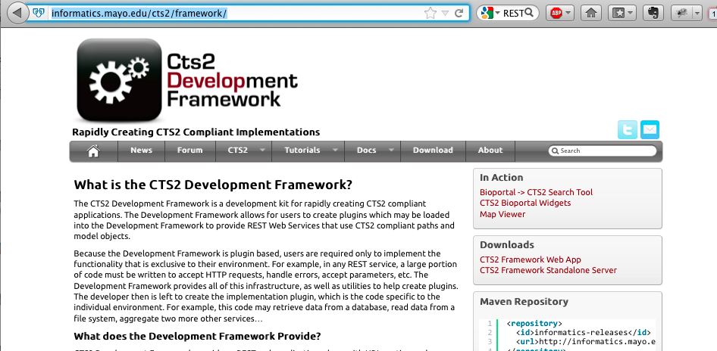
CTS2 Development Framework Overview
CTS2 Development Framework
http://informatics.mayo.edu/cts2/framework/
Notes:
Samples, downloadable code, tutorials, documentation

Slide 137
CTS2 Implementations

Slide 138
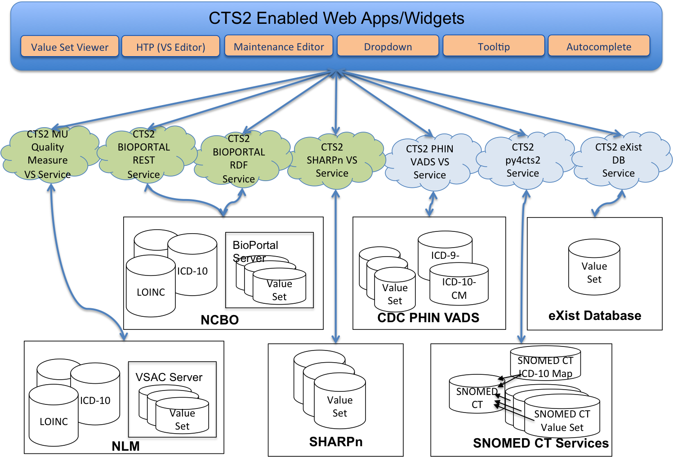
CTS2 Implementations Overview

Slide 139
CTS2 Development Framework Implementations eXist DB
eXist XML Database Plugin:
A CTS2 implementation based on the eXist Database (Open Source Native XML Database)
Functions supported:
READ
QUERY
MAINTENANCE
Notes:
Service supports all resources
Cts2 functional profiles (only one to support Maintenance)

Slide 140
CTS2 Development Framework Implementations eXist DB
Supports the most resources of any CTS2 implementation
Status - Development
Example of how to implement CTS2 using a NO SQL (XML database) backend

Slide 141
CTS2 Development Framework Implementations MU Quality Measure Value Set Service
A CTS2 Query implementation of Value Sets based on Meaningful Use 2 Standards for NQF eMeasures
Value Sets provided by US National Library of Medicine (NLM)
This Implementation is a wrapper around NLM’s REST interface
Notes:
The NLM is the Value Set Authority repository for all meaningful use eMeasures.
This implementation wraps their REST interfaces.
An eMeasure (patients with diabetes or patients with hypertension) contains one or more VS containing concepts. These concepts identify the eMeasure.

Slide 142
CTS2 Development Framework Implementations MU Quality Measure Value Set Service
Functions supported:
READ
QUERY
Resources supported:
Value set
Value set definition
Resolved value set

Slide 143
CTS2 Development Framework Implementations MU Quality Measure Value Set Service
Status – Production
Important service for users that need Meaningful Use value sets in a CTS2 service

Slide 144
CTS2 Development Framework Implementations NCBO BioPortal
Component of the National Center for Biomedical Ontologies (NCBO)
Mission:
Create software and support services for the application of principled ontologies in biomedical science and clinical care, ranging from tools for application developers to software for end-users.
Notes:
Repository for ontologies,
Host ontologies. Provide tools to access the content

Slide 145

CTS2 Development Framework Implementations NCBO BioPortal
Web-based application for accessing and sharing biomedical ontologies
Search for terms
Submit a new ontology to BioPortal library
Views on large ontologies
Explore mappings between ontologies
REST based API
Many useful viewing, browsing and access widgets

Slide 146
CTS2 Development Framework Implementations NCBO BioPortal REST
NCBO BioPortal Wrapper
A CTS2 implementation based on the NCBO BioPortal REST service
Functions supported:
READ
QUERY
Notes:
Based on our experience with the eXist DB plugin, this was our next implementation into an existing datasource
- GOTO the service (click on the link)
Entity, codesystem, codesystem version, value sets

Slide 147
CTS2 Development Framework Implementations NCBO BioPortal REST
Resources supported:
Code System
Code System Version
Value Set
Resolved Value Set
Entity
Association
Status - Production

Slide 148
CTS2 Development Framework Implementations NCBO BioPortal REST
Example of how CTS2 can be implemented as a wrapper over an existing service
Augments (doesn’t replace) existing solutions
Enables users full access to all of the NCBO content through the CTS2 service

Slide 149
CTS2 Development Framework Implementations NCBO BioPortal REST
http://www.bioontology.org/wiki/index.php/CTS2_BioPortal_wrapper
http://informatics.mayo.edu/cts2/rest/valuesets
Notes:
Overview of the wrapper on bioportal’s wiki

Slide 150
CTS2 Framework Implementations NCBO BioPortal RDF
RDF Triplestore Wrapper
A CTS2 implementation based on the NCBO BioPortal SPARQL endpoint
Functions supported:
READ
QUERY
Notes:
NCBOs most recent implementation is RDF
SPARQL – query language for the RDF triple stores
Resource Description Framework (RDF)

Slide 151
CTS2 Framework Implementations NCBO BioPortal RDF
Resources supported:
Code System
Code System Version
Value Set
Resolved Value Set
Entity
Association
Status - Production

Slide 152
CTS2 Framework Implementations NCBO BioPortal RDF
Example of how to implement CTS2 as a wrapper over an RDF backend using SPARQL

Slide 153
CTS2 Framework Implementations NCBO BioPortal RDF
http://www.bioontology.org/wiki/index.php/CTS2_RDF_Plugin
http://informatics.mayo.edu/cts2/services/bioportal-rdf/valuesets
Notes:
Overview of the wrapper on bioportal’s wiki

Slide 154
CTS2 Implementation (using py4cts2)
SNOMED CT RF2 (py4cts2)
A Python implementation of CTS2 to expose the contents of the SNOMED CT RF2 distribution
This service provides REST based access to the SNOMED tables and their equivalent CTS2 rendering
Functions supported:
READ
QUERY
Notes:
Implementation not using the CTS2 Framework
Did this to validate CTS2 could be implemented without the framework.
One case to not use the framework it when you don’t want to use Java. In this case we are using Python.

Slide 155
CTS2 Implementation (using py4cts2)
Resources supported:
Code System
Code System Version
Value Set
Resolved Value Set
Entity
Association
Advanced Association
Status - Development

Slide 156
CTS2 Implementation (using py4cts2)
Most full featured SNOMEDCT implementation
Has RDF output capability
Only CTS2 implementation (to date) that supports the Advanced Association (Graph) CTS2 profile
Implementation of CTS2 that showcases how the CTS2 spec may be implemented in a different language
Notes:
*** Pause for Questions ***
Show CTS2 Viewer Entities window and
http://informatics.mayo.edu/cts2/services/py4cts2/cts2/

Slide 157
CTS2 Implementation (using py4cts2)
Examples
CTS2 Viewer – Entity Details Window
https://informatics.mayo.edu/vsmc/
http://informatics.mayo.edu/cts2/services/py4cts2

Slide 158
Web Applications using the CTS2 Service

Slide 159
Web Applications CTS2 Value Set Viewer
Generic Value Set Viewer to:
Browse value sets and its entities
Search for value sets
Export value sets
Initially created for MU Quality Measure Value Set Service to serve NLM Value Sets
Can view any CTS2 compliant Value Set service (NCBO,PHINVADS CDC,VSAC)
https://informatics.mayo.edu/vsmc/?showAll=true
Notes:
Center for Disease Control (CDC)
Public Health Information Network Vocabulary Access and Distribution System (PHINVADS)
http://www.cdc.gov/phin/tools/PHINvads/index.html

Slide 160
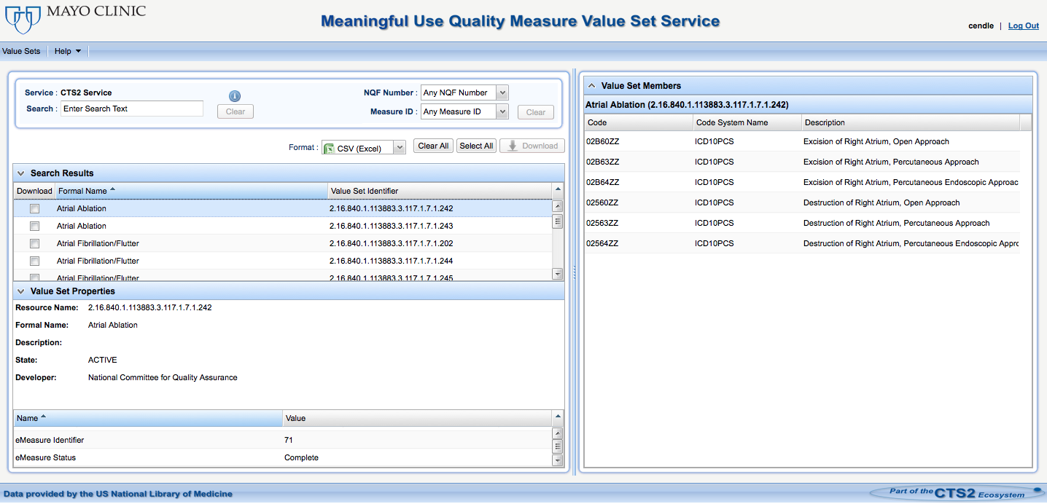
Web Applications CTS2 Value Set Viewer

Slide 161
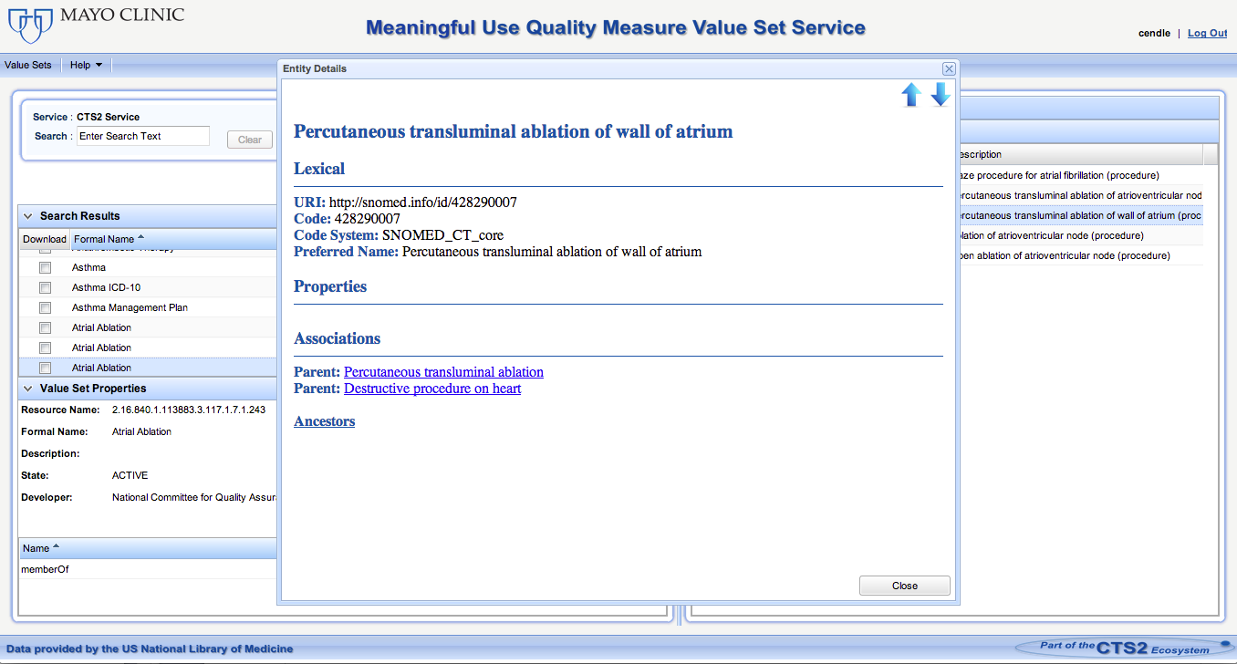
Web Applications CTS2 Value Set Viewer
Using py4cts2 implementation to retrieve entities and their associations

Slide 162
Web Applications High-Throughput Phenotyping (HTP)
A tool to help identify patient cohorts using electronic health record (EHR) data by leveraging informatics-based phenotyping processes
Rules from the National Quality Forum (NQF) Quality Data Model (QDM) files can be uploaded to the Phenotype Portal
Notes:
We using the MU eMeasure applying against patient data to find coharts.

Slide 163
Web Applications High-Throughput Phenotyping (HTP)
Convert structured phenotype criteria into executable queries using JBoss Drools Rules
Runs against Clinical Element Model (CEM) DB and EHRs to find cohorts that match the given criteria

Slide 164
Web Applications High-Throughput Phenotyping (HTP)
Users can currently view Value Sets and their entities via the CTS2 service
Planned availability to add/remove entries from Value Sets and save them. This will allow the user to execute the phenotypes with modified criteria to see how it affects the results
Notes:
Note that the editor is re-usable

Slide 165
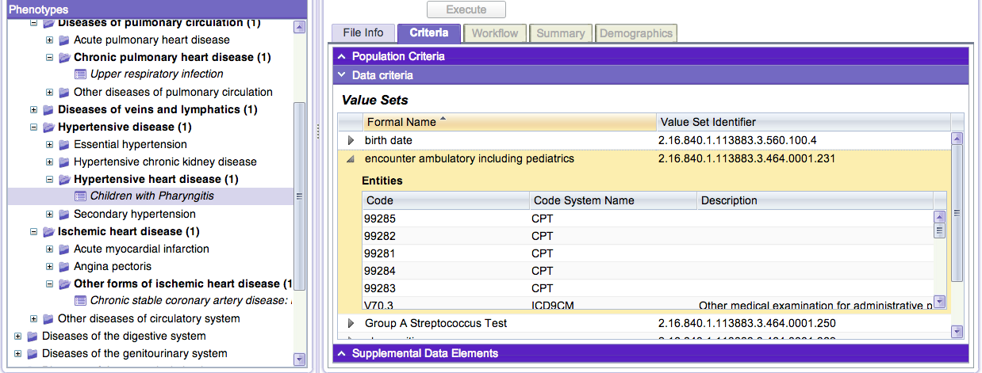
Web Applications High-Throughput Phenotyping (HTP)
http://phenotypeportal.org/

Slide 166
Web Applications CTS2 Maintenance Editor
Application for managing CodeSystems, Entities, and Change Sets
Demonstration of CTS2 maintenance functionality
Currently in development
http://informatics.mayo.edu/exist/cts2/rest/editor/console
Notes:
To help get an understanding of the how the Maintenance Profile works (creating modules, Entries, and Change Sets and Versioning)

Slide 167
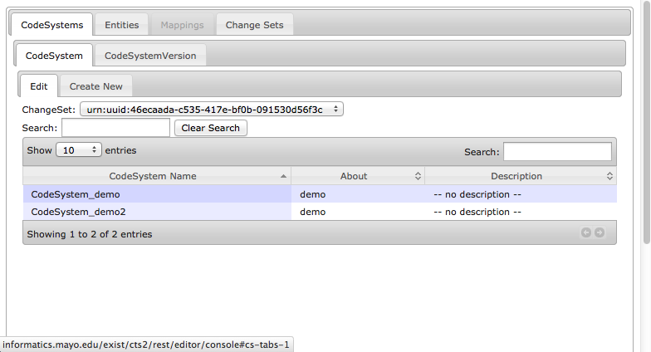
Web Applications CTS2 Maintenance Editor

Slide 168
CTS2 Enabled UI Widgets

Slide 169
CTS2 Enabled UI Widgets Overview
Tooltips
jQuery tooltip widget used to display Value Sets and Code Systems when you mouse over text
Autocomplete
jQuery autocomplete widget used to suggest Value Sets as you type

Slide 170
UI Widgets Overview
Dropdown
jQuery example to fill a select (dropdown) with specific resolved value sets

Slide 171
CTS2 Enabled UI Widgets Demonstration
http://informatics.mayo.edu/cts2widgets/widgets.html
Features and customization points of each widget:
Ability to set the Value Set ID/Code System ID to retrieve different values
Cascading Style Sheets (CSS) to change the look and feel
CTS2 parameterized values to customize the query
Notes:
Go to http://informatics.mayo.edu/cts2widgets/widgets.html

Slide 172
CTS2 Enabled UI Widgets Future
Started out with some simple UI widgets from Mayo
Envision a whole library of CTS2 enabled widgets (including more sophisticated widgets) will be developed over time from:
Mayo
CTS2 community

Slide 173
CTS2 Web Applications/UI Widget Review

Slide 174
CTS2 Web Applications/UI Widget Review
Several examples of web applications and widget to show the power of the CTS2 compliant services
CTS2 compliant web apps and UI widgets can be used to interact with any CTS2 compliant service
Notes:
- Example: Value Set Viewer Web app. Written for MU value set service… can view value sets from any CTS2 compliant value set service.

Slide 175
Questions

Slide 176
References
CTS
http://informatics.mayo.edu/LexGrid/downloads/CTS/specification/ctsspec/cts.htm
LexEVS
https://cabig-kc.nci.nih.gov/Vocab/KC/index.php/LexEVS
BioPortal
http://bioportal.bioontology.org/
BioPortal REST Services
http://www.bioontology.org/wiki/index.php/BioPortal_REST_services
CTS2
http://informatics.mayo.edu/cts2

Slide 177
References
CTS2 Development Framework
http://informatics.mayo.edu/cts2/framework/
Healthcare Services Specification Program
http://hssp.wikispaces.com/
BioPortal REST Wrapper
http://informatics.mayo.edu/cts2/rest/valuesets
BioPortal RDF Wrapper
http://informatics.mayo.edu/cts2/services/bioportal-rdf/valuesets
BioPortal SPARQL endpoint:
http://sparql.bioontology.org/

Slide 178
References
MU Quality Measure Value Set Service
https://informatics.mayo.edu/cts2/services/mat/valuesets
GUIs that display CTS2 Content:
https://informatics.mayo.edu/vsmc/?showAll=true
http://www.phenotypeportal.org/
http://informatics.mayo.edu/exist/cts2/rest/editor/console
UI Widgets Example:
http://informatics.mayo.edu/cts2widgets/widgets.html
UI Widgets in GitHub:
https://github.com/cts2/
https://github.com/cts2/cts2autocomplete
https://github.com/cts2/cts2tooltip
https://github.com/cts2/cts2dropdown

Slide 179
Questions & Discussion

